Slide 1




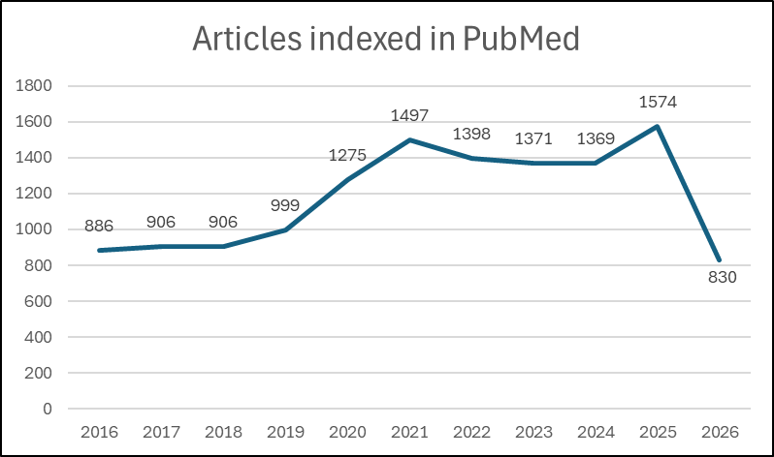
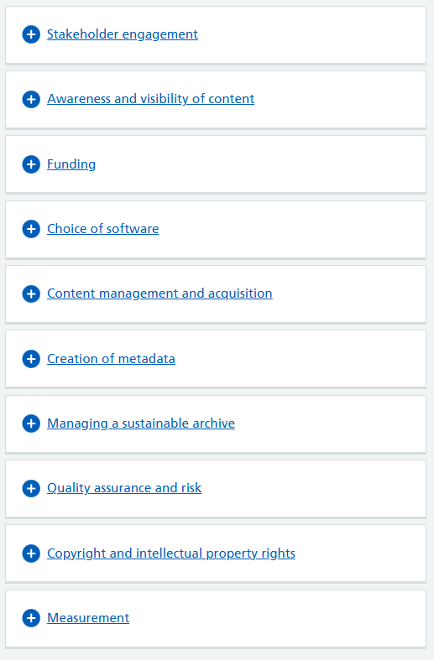
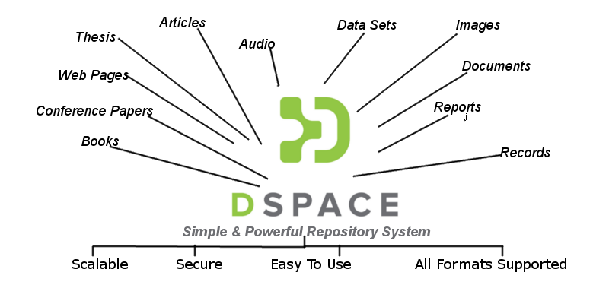
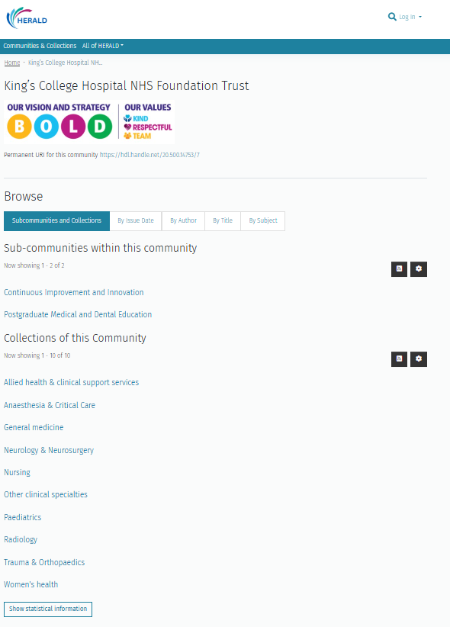
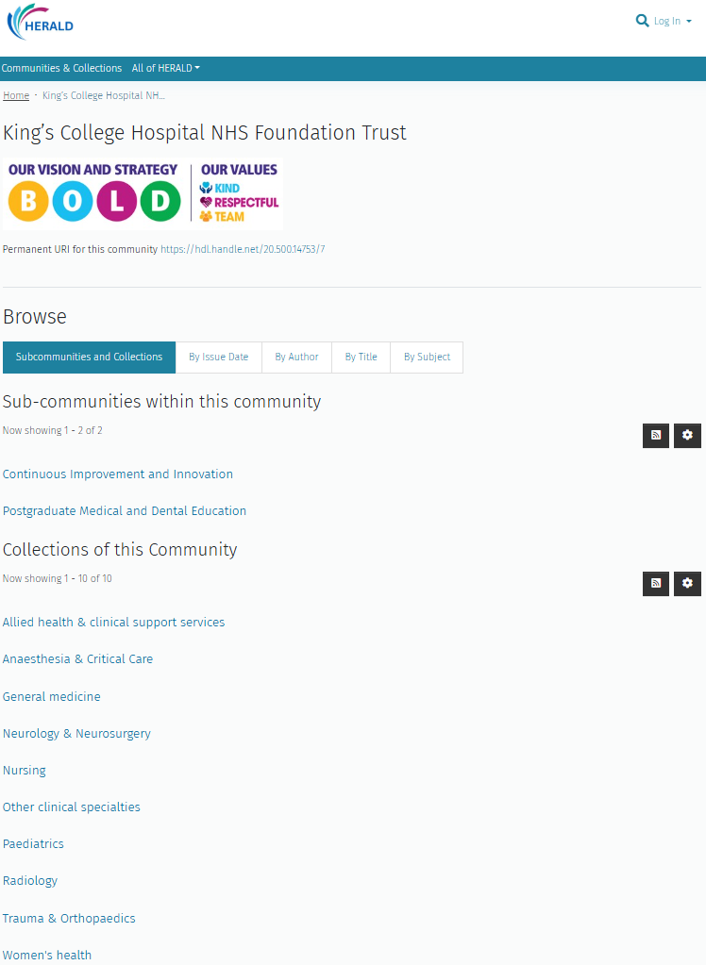
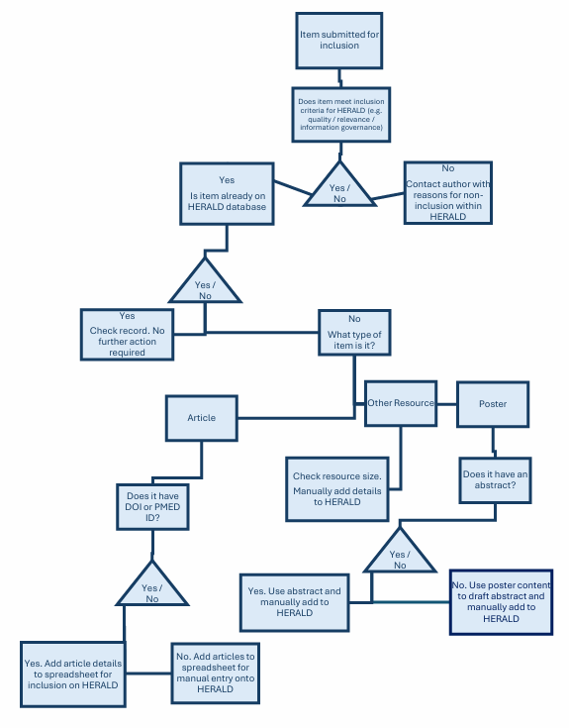
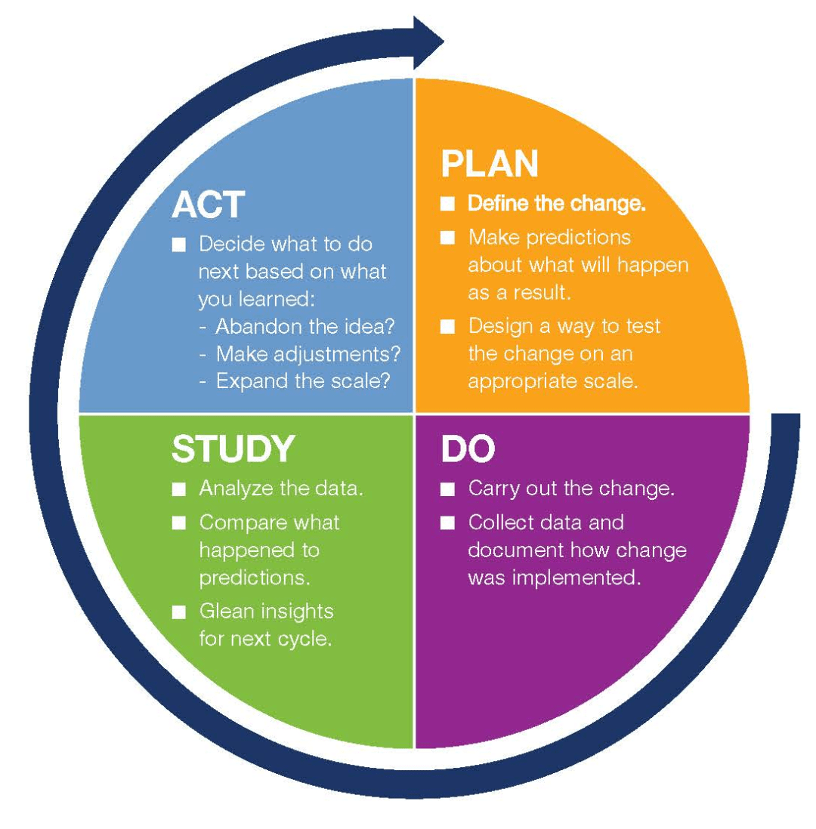
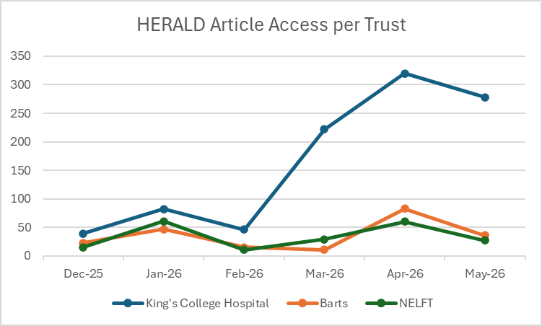
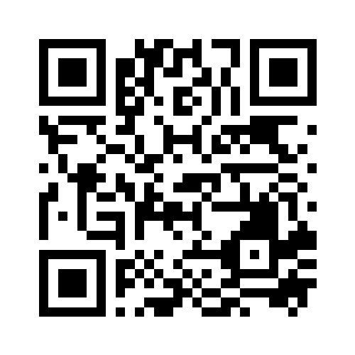
Establishment of an Institutional Repository for King’s Staff
Project leads: Doug Knock, Sarah O’Reilly & Kate Clifford​
1. Aim and Measures
2. Why This Matters
3. Ideas and Tests of Change
Aim: King’s College Hospital is a leader
in health research, innovation and education.
A key element of being a leader in research
and innovation is the ability to share
knowledge and experience both within
King’s and externally across the wider
healthcare sector.
The establishment of the HERALD institutional repository for King’s staff aims to
Increase visibility and access to publications authored by King’s staff
Enhance knowledge sharing and patient outcomes within King’s
Measures: Measuring research output can involve a mix of quantitative metrics and qualitative assessment to evaluate productivity and impact. HERALD will provide quantitative date through the number of articles and additional resources that have been included as well as the actual usage data relating to specific collections and resource types.
Quantitative data will need to be supplemented by qualitative data gathered through a combination of staff engagement and feedback.
King’s College Hospital staff have published in excess of 1,000 journal articles every year since 2020. This does not include
“grey literature”
such as
unpublished
presentations,
posters and
reports.
Institutional
NHS repositories
offer significant advantages by capturing, storing, and sharing the knowledge output of the organisation, such as research, audits, policies, and quality improvement reports. Repositories increase the visibility of research and drive knowledge management across Trusts whilst preventing duplication of effort and the loss of "grey literature”.
Previous projects at King’s have sought to share organisational knowledge with limited success. These have included the Articles by King’s Kwiki page (limited navigation, not user friendly); KingsWeb Live Publications on the Quality Improvement SharePoint platform (access on demand, no search functionality); Individual article promotion via KingsWeb (time intensive, unstructured) and
Focus on King’s Current Awareness alert
(selected articles, no search functionality).
Critically none of these are available externally,
provide effective search functionality or any
meaningful statistical data .
A scoping exercise of existing NHS
Repositories* identified DSpace as a viable
option meeting key criteria. NHSE facilitated a
partnership between King’s, NELFT and Bart’s
with a view to developing a London-wide
Repository hosted by Atmire.
* NHSE Institutional Repository Database https://library.hee.nhs.uk/resources/open-access/institutional-repositories-database
NHSE - Creating an institutional repository
https://library.hee.nhs.uk/resources/open-access/institutional-repositories/
4. Tools Used
5. Results
6. Value and Impact
What quality improvement methods helped guide your work?
DSpace is a widely used, open-source
repository software that captures, stores,
indexes, preserves, and redistributes digital
research material. It acts as an institutional
repository for universities, libraries, and
research organizations to manage digital
content, including scholarly publications,
datasets, and multimedia.
PDSA Cycle
The Plan Do Study Act Cycle four-stage
problem-solving model is being used to help
monitor the implementation of the
HERALD institutional repository.
The process is currently within the
‘Do’ stage following the design and
launch of the repository. Data is
currently being collected which
will be analysed and reviewed.
Launch: 17th April 2026
Number of Articles: 1373
Number of posters: 9
Item accesses: 987
Data collected 31/5/2026
Promotion to
OpenAthens account holders
Via KingsWeb
Outreach to Continuous
Improvement Dept.
Outreach to Research Dept.
Current Awareness alerts
Clinical staff including trainees
HERALD will help highlight the research that is being undertaken at King’s, supporting our aspiration to be a research leading organization.
Over 250 King’s staff now have their articles accessible via HERALD with over 275 articles accessed per month since the official launch.
There are currently 9 posters providing unique full-text access via HERALD. These have been accessed 121 times since April. Unlike the published articles these unpublished resources would not have been available elsewhere.
We are experiencing a gradual increase in direct submissions of material onto HERALD by King’s staff. This will help ensure
that information and
knowledge that
was previously
isolated, is now
readily accessible on
a single online platform.
Process Mapping
A process map has been set up
to monitor the submission of new resources onto HERALD.
Try
HERALD
here
Total number of item accesses 31/5/26
Contact kch-tr.br-library@nhs.net
for further support

